Slide 1
BITWISE OPERATORS

Slide 2
Bitwise operators are used to perform operations on individual bits of numbers. These operators are commonly used in low-level programming, such as in system programming, cryptography, and embedded systems.

Slide 3
Bitwise operations take one or more bit-patterns or binary numerals and manipulate them at the bit level. They’re essentially our tool to manipulate bits to achieve our operations. While arithmetic operations perform operations on human-readable values (1+2), bitwise operators manipulate the low-level data directly. Advantages ➢ They are fast and simple actions. ➢ They are directly supported by the processor. ➢ They are used to manipulate values for comparisons and calculations. ➢ Bitwise operations are incredibly simple and faster than arithmetic operations.

Slide 4
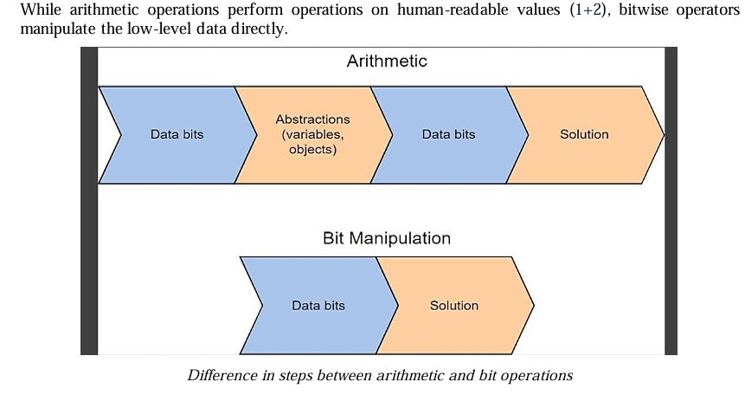

Slide 5
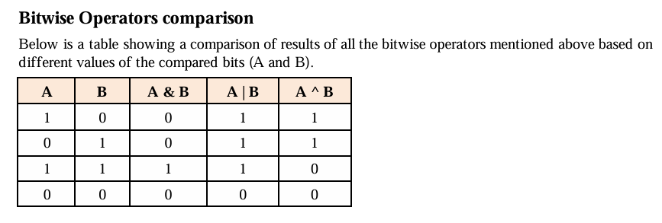

Slide 6
BITWISE OPERATORS
Operator | Symbol | Description | Example (A = 5, B = 3)
AND | & | Sets each bit to 1 if both bits are 1 | 5 & 3 = 1 (0101 & 0011 = 0001)
OR | | | | | Sets each bit to 1 if at least one bit is 1
XOR | ^ | Sets each bit to 1 if only one of the bits is 1 | 5 ^ 3 = 6 (0101 ^ 0011 = 0110)
NOT | ~ | Inverts all bits (bitwise complement) | ~5 = -6 (in 8-bit, ~00000101 = 11111010)
Left Shift | << | Shifts bits to the left (multiplies by 2) | 5 << 1 = 10 (00000101 << 1 = 00001010)
Right Shift | >> | Shifts bits to the right (divides by 2) | 5 >> 1 = 2 (00000101 >> 1 = 00000010)

Slide 7
1. Check if a Number is Even or Odd using Bitwise AND CLUE - A number is even if the least significant bit (LSB) is 0 and odd if it is 1. You can use n & 1 to check this. Refer – BitwiseEvenOdd.java

Slide 8
2. Swap Two Numbers Without Using a Temporary Variable Hint: XOR swapping: Refer BitwiseSwap.java

Slide 9
3. Given an array where every element appears twice except for one, find that single element. Use XOR of two same numbers is 0 (i.e., x ^ x = 0). XOR all elements; the duplicate numbers cancel out, leaving the unique number. Refer – SingleNumber.java

Slide 10
4. Multiply a Number by 2 Without Using * Question: Write a Java program to multiply a number by 2 using a bitwise operator. Hint: Left shift << moves bits left, effectively multiplying by 2. Refer- MultiplybyTwo.java Refer - MultiplyByTwo.java

Slide 11
5. Count the Number of Set Bits (1s) in an Integer Question: Write a Java program to count the number of 1s in the binary representation of a number. Hint: Use n & (n - 1), which turns off the rightmost set bit. Refer – CountSetBits.java

